Slide 1
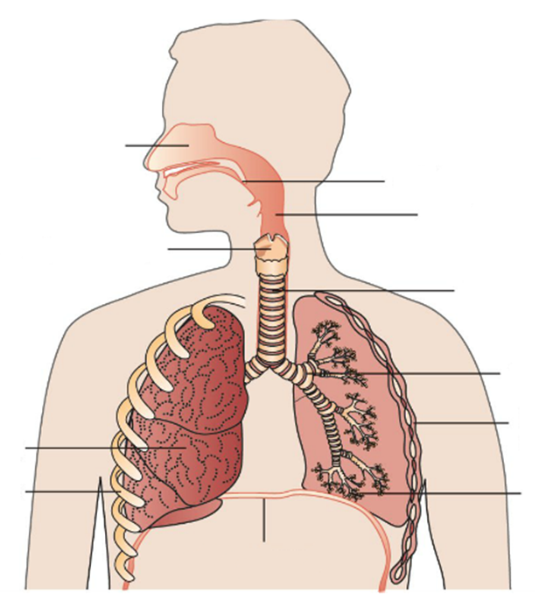
Concept Development
The Respiratory System – Respiratory Tract
Match the following terms with the labels on the respiratory tract
Larynx
Nasal Cavity
Pharynx
Trachea
Epiglottis
Bronchus
Lungs
Alveoli
A
B
C
D
E
F
G
H
Vocabulary
Inhale: breathe in Exhale: breathe out

Slide 2
Breathing and Gas Exchange

Slide 3
Concept Development
CFU 1
What forms a cage around the lungs?
The Respiratory System – Support Organs
The ribs form a protective cage around the lungs.
The intercostal muscles are muscles between the ribs that help us breathe.
The diaphragm is a sheet of muscle that is attached to the ribs.
Nasal cavity
Epiglottis
Pharynx
Larynx
Trachea
Bronchus
Intercostal Muscles
Lung
Ribs
Alveoli
CFU 2
Where would you find intercostal muscles?
CFU 3
What is the diaphragm?
Diaphragm
Vocabulary
Inhale: breathe in Exhale: breathe out

Slide 4
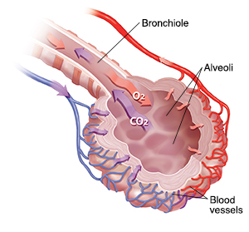
Skill Development
CFU 1
What is the function of the alveoli?
CFU 2
What surrounds each alveolus?
CFU 3
What role does blood play in gas exchange?
The Function of Organs in the Respiratory System
The alveoli exchange oxygen and carbon dioxide.
They are surrounded by a mesh of tiny blood vessels.
Oxygen moves into the blood and carbon dioxide moves out of the blood.
Vocabulary
Inhale: breathe in Exhale: breathe out

Slide 5
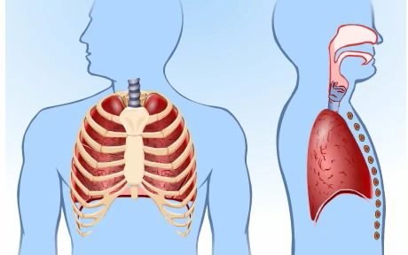
Skill Development
CFU 1
Why are the lungs unable to move on their own?
CFU 2
Which muscles work together to allow the body to breathe?
Breathing
The lungs have no muscles, so cannot move on their own.
Breathing occurs when the diaphragm and intercostal muscles work together.
The muscles contract to expand the chest and draw air into the lungs.
When the muscles relax, the chest deflates and pushes air out of the lungs.
CFU 3
How is the body able to move air into and out of the lungs?
Vocabulary
Inhale: breathe in Exhale: breathe out

Slide 6
Independent Practice
You will now make a model of mammalian lungs

